Slide 1

Technology in Action
Alan Evans • Kendall Martin
Mary Anne Poatsy
Eleventh Edition
Notes:
Welcome to Chapter 5: System Software: The Operating System, Utility Programs, and File Management

Slide 2
Technology in Action
Chapter 5
System Software: The Operating System, Utility Programs, and File Management
Notes:
This chapter discusses system software and how vital it is to your computer. We will examine the operating system (OS) by looking at the different operating systems on the market as well as the tasks the OS manages. We’ll also discuss how you can use the OS to keep your files and folders organized so that you can use your computer more efficiently. Finally, we’ll look at the many utility programs included as system software on your computer.

Slide 3
Chapter Topics
Operating System Fundamentals
What the Operating System Does
The Boot Process: Starting Your Computer
The Windows Interface
Organizing Your Computer: File Management
Utility Programs
Notes:
Chapter topics include:
Operating System Fundamentals
What the Operating System Does
The Boot Process: Starting Your Computer
The Windows Interface
Organizing Your Computer: File Management
Utility Programs

Slide 4
Understanding System Software: Operating System Fundamentals
Two basic types of software
Application software
System software
Notes:
Computers uses two basic types of software: application software and system software.
Application software is the software you use to do everyday tasks.
System software is the set of programs that helps run the computer and coordinates instructions between application software and the computer’s hardware devices.

Slide 5
Understanding System Software: Operating System Fundamentals (cont.)
Two basic types of System software
Operating system
Utility program
Notes:
System software consists of two primary types: the operating system and utility programs.
The operating system (OS) is a group of programs that controls how your computer system functions. It does the following:
Manages the computer’s hardware and peripheral devices.
Provides a consistent means for application software to work with the central processing unit (CPU)
Is responsible for the management, scheduling, and coordination of tasks
You interact with your OS through the user interface—the desktop, icons, and menus.
A utility program is a small program that performs many general housekeeping tasks for your computer.

Slide 6
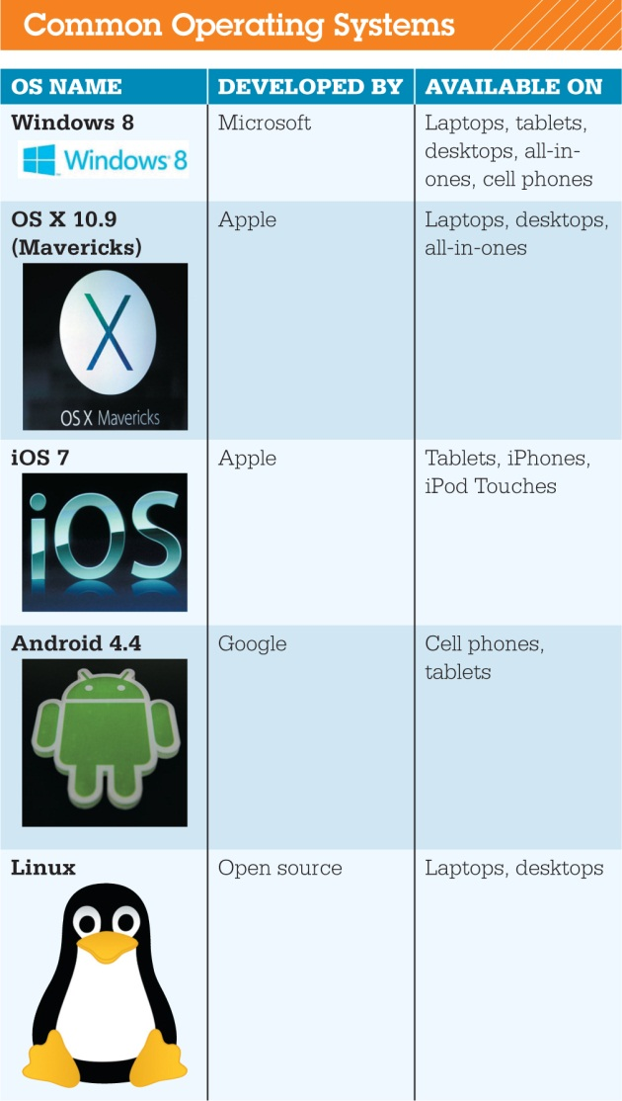
Understanding System Software: Operating System Fundamentals (cont.)
Categorized by device
Mainframes
Network computers
Personal computers
Mobile devices
Robots
Notes:
Every computer has an OS. Even smartphones, game consoles, cars, and some appliances have operating systems. The role of the OS is critical; the computer can’t operate without it.
Laptops, tablet computers, and smartphones all need specific operating systems designed to take advantage of their unique characteristics. As devices begin to converge in terms of functionality, and operating systems continue to become more powerful, developers such as Microsoft and Apple are making operating systems that have similar functionality (such as OS X and iOS) or are making single operating systems (such as Windows 8) that can run on multiple devices.

Slide 7
Understanding System Software: Operating System Fundamentals (cont.)
Operating System Fundamentals
Multitasking
Networking capabilities
Categorized by type
Notes:
Modern operating systems allow a single user to multitask—to perform more than one process at a time. Operating systems such as Windows and OS X provide networking capabilities as well, essentially making them multiuser, multitasking operating systems.
Operating systems can be categorized by the type of device on which they’re installed, such as robots and specialized equipment with built-in computers, mainframes and network computers, mobile devices, and personal computers.

Slide 8

Understanding System Software: Real-Time Operating Systems
Used for machinery
Minimal user interaction
Car engines
Medical devices
Common appliances
Robotic cameras
Notes:
Machinery that performs a repetitive series of specific tasks in an exact amount of time requires a real-time operating system (RTOS). RTOSs require minimal user interaction. This type of OS is a program with a specific purpose, and it must guarantee certain response times for particular computing tasks.
Devices that must perform regimented tasks or record precise results—such as measurement instruments found in the scientific and aerospace industries—require RTOSs.
You encounter RTOSs in devices such as fuel-injection systems in car engines and some common appliances. RTOSs are also found in many types of robotic equipment.

Slide 9
Understanding System Software: Operating Systems for Networks, Servers, and Mainframes
Multiuser operating system
Networks
Manage user requests
Examples
Windows Server
Linux
UNIX
Notes:
A multiuser operating system lets more than one user access the computer system at a time by handling and prioritizing requests from multiple users. Networks need a multiuser OS because many users simultaneously access the server (the computer that manages network resources such as printers).
The latest versions of Windows and OS X can be considered network operating systems: They enable users to set up basic networks in their homes and small business. In larger networks, a more robust network OS is installed to manage all user requests.
Examples of network operating systems include Windows Server, Linux, and UNIX.

Slide 10
Understanding System Software: Operating Systems for Networks, Servers, and Mainframes (cont.)
UNIX
Multiuser, multitask operating system
Network operating system used primarily with mainframes
The Open Group
Notes:
UNIX is a multiuser, multitask OS that is used as a network OS, primarily with mainframes, although it’s also often found on PCs.
Developed in 1969, the UNIX code was initially not proprietary.
UNIX is now a brand that belongs to the company The Open Group, but any vendor that meets testing requirements and pays a fee can use the UNIX name.
Individual vendors then modify the UNIX code to run on their hardware.
Mainframes and supercomputers also require multiuser operating systems. Examples of mainframe operating systems include UNIX, Linux on System z, and IBM’s z/OS.

Slide 11
Understanding System Software: Operating Systems for Mobile Devices
Smartphones
Multitasking capabilities
Gaming systems and personal media players
Require system software developed for the device
Notes:
Most smartphones have a least modest multitasking capabilities. More advanced smartphones provide greater multitasking, such as letting you talk and use apps at the same time.
Popular tablet operating systems include iOS, Android, and Windows. iPads use iOS. A number of different tablets use versions of Android. Until the release of Windows 8, Microsoft didn’t have a popular tablet OS, but the company has managed to grab a 4.5% market share releasing Windows 8.
Gaming systems like Microsoft's Xbox 360, the Nintendo Wii, and the Sony PlayStation, as well as personal media players, all require system software.

Slide 12
Understanding System Software: Operating Systems for Personal Computers
Top three operating systems
Windows
Max OS X
Linux
Windows 8 for touch screen
Notes:
Microsoft Windows, Mac OS X, and Linux are the top three operating systems for personal computers. Although they share similar features, each is unique.
Microsoft Windows is an operating environment that incorporates a user-friendly, visual interface like the one that was first introduced with Apple’s OS.
The newest release of Microsoft’s OS, Windows 8, has a new interface optimized for touch-screens.
Windows 8 offers only two versions: Windows 8 and Windows 8 Pro. Windows 8 doesn’t include Media Center. Media Center is now available as an add-on package for Windows 8 Pro.
Windows 8.1 is the latest release available.

Slide 13
Understanding System Software: Operating Systems for Personal Computers (cont.)
Mac OS
Mavericks
Mac OS X based on UNIX
Notes:
In 1984, Mac OS became the first commercially available OS to incorporate a graphical user interface (GUI) with user-friendly point-and-click technology. The latest version, Mavericks, adds many of the popular and innovative features loved by iOS users, such as messages, reminders, notes, and a notification center.
OS X uses the same desktop metaphors as Windows, including icons for folders and a Trash Can (similar to a Recycle Bin) for deleted documents.
Mac OS X is based on the UNIX operating system, which is exceptionally stable and reliable.

Slide 14
Understanding System Software: Operating Systems for Personal Computers (cont.)
Linux
Open source OS
Personal computer and network OS
Stable OS
Quickly modified or updated
Download as distros
Notes:
Linux is an open source OS designed for use on personal computers and as a network OS. Open source software is freely available for anyone to use or modify. Linux has been tweaked by scores of programmers as part of the Free Software Foundation GNU Project (gnu.org).
Linux has a reputation as a stable OS.
Android, the tablet and phone OS, is Linux-based.
Linux is available for download in various packages known as distributions, or distros. Distros include the underlying Linux kernel and special modifications to the OS. A good place to start researching distros is distrowatch.com.

Slide 15
Understanding System Software: Operating Systems for Personal Computers (cont.)
Platform
Windows and Linux can run on most hardware sold today
Application software is OS-dependent
Notes:
The combination of an OS and a specific processor is referred to as a computer’s platform.
Computers and other devices usually come with an OS already installed. However, with some PCs, you can specify which OS you’d like installed when you order your device.
Windows and Linux can run on most hardware being sold today. Your decision of an OS in this case is mostly a matter of price and personal preference.
Apple equipment comes with Apple operating systems preinstalled.
Note that most application software is OS-dependent. You need to make sure you get the correct version for your OS.

Slide 16
Understanding System Software: Operating Systems for Personal Computers (cont.)
More than one OS on one computer
Boot Camp utility in OS X
Parallels or VMware Fusion for Windows
Partition hard drive in Windows
Notes:
Many people run more than one OS because different operating systems offer different features. Windows and Linux both run well on Apple computers. If you want to run both Mac OS X and Windows OS at the same time, you can create “virtual drives” using virtualization software such as Parallels or VMware Fusion.
In Windows you can create a separate section of your hard drive and install another OS on it while leaving your original Windows installation. After installing the second OS, you’re offered a choice of which OS to use.

Slide 17
Understanding System Software: Operating Systems for Personal Computers (cont.)
Cloud-based OS
Prototypes being developed
Still need a computer, operating system, and web browser
Enables users to access applications and content via the web anywhere, on any machine, and at any time
Google is taking steps toward developing a complete web-based operating system
Notes:
Operating systems now have features that are tied to cloud computers. Here are a few examples:
Using your Microsoft account, Windows 8 stores your settings and keeps track of applications purchased from the Windows store. Files can be stored and accessed in your OneDrive account.
OS X Mavericks allows you to sign in with your Apple ID, which provides access to Apple’s iCloud system.
Google has launched the Google Chrome OS. The main functionality of the OS is provided by accessing the web through a web browser. It is only available on certain hardware called Chromebooks.

Slide 18
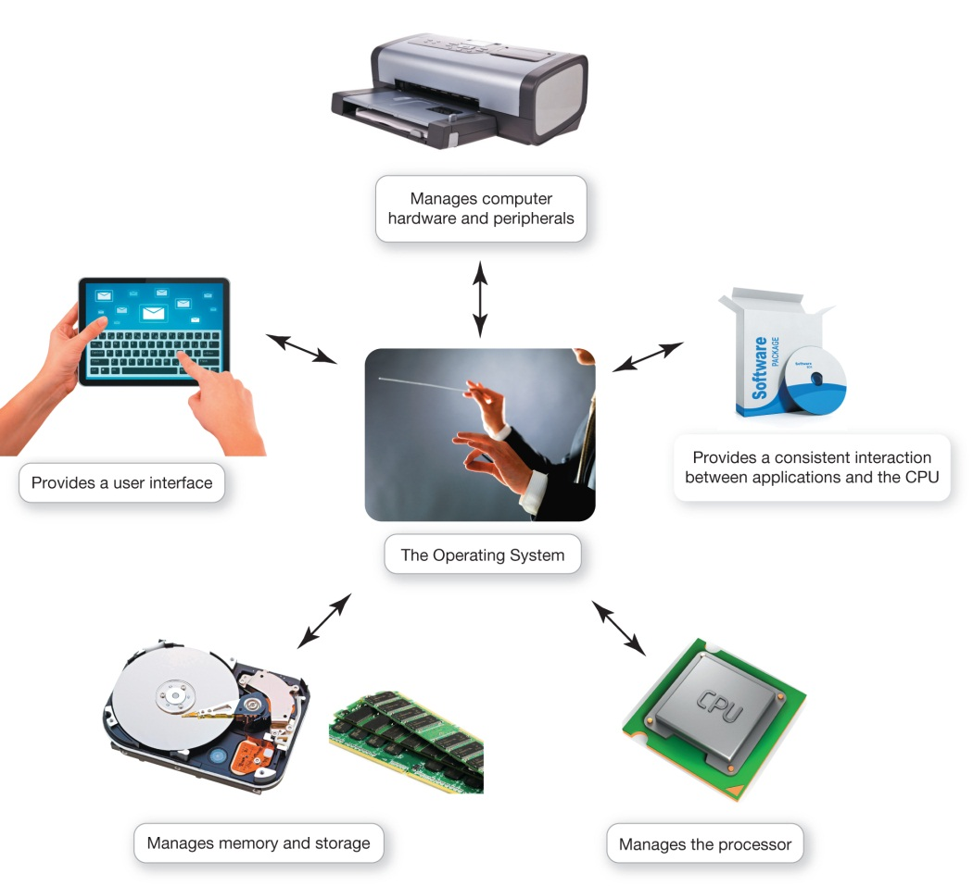
What the Operating System Does
OS: Coordinates and directs the flow of data and information through the computer system
Notes:
The operating system coordinates and directs the flow of data and information through the computer system.

Slide 19
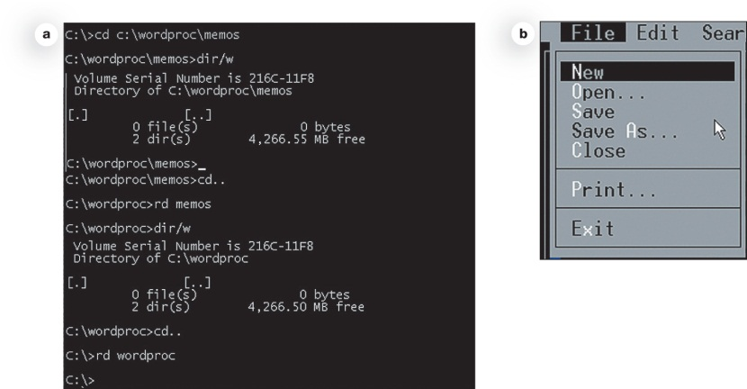
What the Operating System Does: The User Interface
Enables user to interact with the computer
Types of interfaces
Command-driven interface
Menu-driven interface
Graphical user interface (GUI)
Notes:
The OS provides a user interface that lets you interact with the computer. The first computers used Microsoft Disk Operating System (MS-DOS), which had a command-driven interface. A command-driven interface is one in which you enter commands to communicate with the computer system.
The command-driven interface was later improved by incorporating a menu-driven interface. A menu-driven interface is one in which you choose commands from menus. Menu-driven interfaces eliminated the need for users to know every command. However, they were still not easy enough for most people to use.

Slide 20
What the Operating System Does: The User Interface (cont.)
Graphical user interface (GUI)
Windows and Mac OS
Linux
GNOME
KDE
Notes:
Current personal computer operating systems such as Microsoft Windows and Mac OS use a graphical user interface, or GUI (pronounced “gooey”). Unlike command- and menu-driven interfaces, GUIs display graphics and use the point-and-click technology of the mouse and cursor, making them much more user-friendly.
Linux-based operating systems do not have a single default GUI interface. Instead, users are free to choose among many commercially available and free interfaces, such as GNOME and KDE, each of which provides a different look and feel.

Slide 21
What the Operating System Does: Processor Management
CPU performs several tasks at once
OS arranges for execution of activities
Assigns time to each activity
Switches among processes
Appears everything happens seamlessly
Notes:
When you use your computer, you’re usually asking the processor to perform several tasks at once. You might be printing a Word document, chatting with your friends, and watching a movie.
Although the CPU is powerful, it still needs the OS to arrange the execution of these activities in a systematic way.
The OS assigns a slice of its time to each activity. It then switches among different processes millions of times a second to make it appear that everything is happening seamlessly. Otherwise, you wouldn’t be able to watch a movie and print at the same time without experiencing delays.

Slide 22
What the Operating System Does: Processor Management (cont.)
Event
Sequentially or concurrently
OS switches back and forth
Notes:
Every keystroke, every mouse click, and each signal to the printer and from the Blu-ray drive creates an action, or event, in the respective devices (keyboard, mouse, Blu-ray drive, or printer) to which the OS responds.
Sometimes these events occur sequentially (such as when you type characters one at a time), but other events involve two or more devices working concurrently (such as the printer printing while you type and watch a movie).

Slide 23
What the Operating System Does: Processor Management (cont.)
Interrupt
Interrupt handler
Preemptive multitasking
Notes:
Although it looks as though all the devices are working simultaneously, the OS actually switches back and forth among processes. Assume you’re typing and want to print. When you tell your computer to print your document, the printer generates an interrupt that tells the OS that it’s in need of immediate attention. Every device has its own type of interrupt, which is associated with an interrupt handler, a special numerical code that prioritizes the requests. These requests are placed in the interrupt table in the computer’s RAM. The OS processes tasks in order of priority. This is called preemptive multitasking.

Slide 24
What the Operating System Does: Processor Management (cont.)
When OS receives interrupt:
Suspends current activity
Creates memo in the stack
Notes:
When the OS receives the interrupt from the printers, it suspends current activity, and puts a “memo” in a special location in RAM called a stack. The memo is a reminder of what the CPU was doing before it started to work on the printer request. The CPU then retrieves the printer request from the interrupt table and begins to process it. On completion of the printer request, the CPU goes back to the stack, retrieves the memo and returns to that task until it is interrupted again, in a very quick and seamless fashion.

Slide 25
What the Operating System Does: Processor Management (cont.)
OS coordinates activities for peripheral devices
Notes:
The OS also coordinates multiple activities for peripheral devices such as printers. When the processor receives a print request, it first checks with the OS to ensure that the printer is not already in use. If it is, the OS puts the request in a temporary storage area called the buffer. The request waits until the spooler, a program that helps coordinate all print jobs being sent to the printer, indicates the printer is available. If more than one job is waiting, a queue is formed so that the printer can process the requests in order.

Slide 26
What the Operating System Does: Memory and Storage Management
OS uses RAM as a temporary storage
Processor accesses these instructions and data from RAM
OS is responsible for coordinating space allocation in RAM
Clears item from RAM when processor no longer needs them
Notes:
As the OS coordinates the activities of the processor, it uses RAM as a temporary storage area for instructions and data the processor needs.
The processor then accesses these instructions and data from RAM when it is ready to process them.
The OS is therefore responsible for coordinating the space allocations in RAM to ensure that there is enough space for all of the pending instructions and data. It then clears the items from RAM when the processor no longer needs them.

Slide 27
What the Operating System Does: Virtual Memory
RAM
Limited capacity
When RAM is full, instructions and data are stored on the hard drive
Borrowing hard drive space is called virtual memory
Increase RAM to avoid using virtual memory
Notes:
RAM has limited capacity. When there isn’t enough room for the OS, it borrows room from the hard drive.
This process is called virtual memory.
When more RAM space is needed, the OS swaps out data or instructions that have not been recently used and moves them to a temporary storage area called the swap file (or page file).
If the data or instructions are needed later, the OS swaps them back. This process is known as paging.
Excessive paging is called thrashing.
The solution to this problem is to increase the amount of RAM.

Slide 28
What the Operating System Does: Hardware and Peripheral Device Management
Device drivers
Notes:
Each device attached to your computer comes with a special program called a device driver that facilitates communication between the device and the OS.
The device driver translates the device’s specialized commands into commands that the OS can understand, and vice versa. Devices wouldn’t function without the proper device drivers because the OS wouldn’t know how to communicate with them.
Most devices, such as flash drives, mice, keyboards, and digital cameras, come with the driver already installed in Windows. The devices with included drivers in Windows are called Plug and Play devices.

Slide 29
What the Operating System Does: Hardware and Peripheral Device Management (cont.)
Plug and Play (PnP)
Notes:
Plug and Play (PnP) is a software and hardware standard designed to facilitate the installation of new hardware by including the drivers in the OS. PnP lets you plug a new device into your computer and immediately use it.
Sometimes you might have a device that is so new the drivers aren’t yet available automatically in Windows. You’ll then be prompted to insert the driver that was provided with the device or downloaded from the internet. If you don’t have the driver you can often download it from the manufacturer’s website or go to websites like DriverZone (driverzone.com).

Slide 30
What the Operating System Does: Software Application Coordination
For programs to work, they must contain code the CPU recognizes
Application programming interface (API)
Notes:
For programs to work, they must contain code the CPU recognizes. Rather than having the same blocks of code for similar procedures in each program, the OS includes the blocks of code—called an application programming interface (API) —that application software needs to interact with the CPU.
To create applications that can communicate with the OS, software programmers need only refer to the API code blocks. APIs prevent redundancies in code and make it easier for developers to respond to changes in the OS. Software companies also use APIs to give applications in software suites a similar interface and functionality.

Slide 31
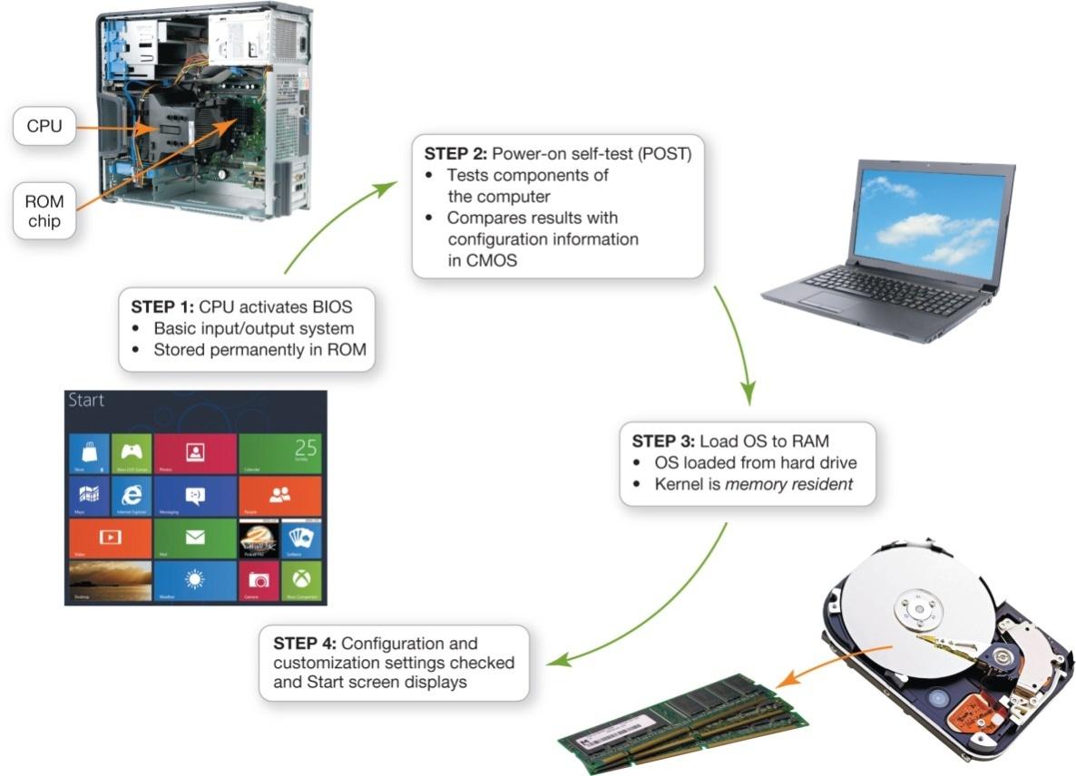
The Boot Process: Starting the Computer
The boot process loads the operating system into RAM
Notes:
All data and instructions (including the OS) are stored in RAM while your computer is on. When you turn off your computer, RAM is wiped clean of all its data. How does the computer know what to do when you turn it on if there is nothing in RAM? It runs through a special boot process (or start-up process) to load the OS into RAM. The term boot, from bootstrap loader (a small program used to start a larger program), alludes to the straps of leather, called bootstraps, that people used to use to help them pull on their boots.

Slide 32
The Boot Process: Starting the Computer: Step 1: Activating BIOS
CPU activates the basic input/output system (BIOS)
BIOS
Loads OS into RAM
Stored on ROM
Notes:
In the first step of the boot process, the CPU activates the basic input/output system (BIOS). BIOS is a program that manages the exchange of data between the OS and all the input and output devices attached to the system. BIOS is also responsible for loading the OS into RAM from its permanent location on the hard drive. BIOS itself is stored on a read-only memory (ROM) chip on the motherboard. Unlike data stored in RAM, data stored in ROM is permanent and is not erased when the power is turned off.

Slide 33
The Boot Process: Starting the Computer: Step 2: Performing the Power-On Self-Test
Power-on self-test (POST)
CMOS—complementary metal-oxide semiconductor
Notes:
The first job BIOS performs is to ensure that essential peripheral devices are attached and operational—a process called the power-on self-test or POST. The BIOS compares the results of the POST with the various hardware configurations permanently stored in CMOS (pronounced “see-moss”). CMOS, which stands for complementary metal-oxide semiconductor, is a special kind of memory that uses almost no power.
CMOS contains information about the system’s memory, types of disk drives, and other essential input and output hardware components. If the results of the POST compare favorably with the hardware configurations stored in CMOS, the boot process continues.

Slide 34
The Boot Process: Starting the Computer: Step 3: Loading the OS
System files
Loads OS into RAM
Kernel is loaded
Kernel: essential component of the OS
Responsible for managing the processor and all components
Notes:
Next, BIOS goes through a preconfigured list of devices in its search for the drive that contains the system files, the main files of the OS. When it is located, the OS loads into RAM.
Once the system files are loaded into RAM, the kernel (or supervisor program) is loaded. The kernel is the essential component of the OS, responsible for managing the processor and all other components of the computer system.
Other less critical parts of the OS stay on the hard drive and are copied over as-needed. Once the kernel is loaded, the OS takes over control.

Slide 35
The Boot Process: Starting the Computer: Step 4: Checking Further Configurations and Customizations
Checks registry for configuration of other system components
Authentication
Notes:
Finally, the OS checks the registry for the configuration of other system components. The registry contains all the different configurations (settings) used by the OS and by other applications. It contains the customized settings you put into place, such as mouse speed, as well as instructions as to which programs should be loaded first.
The verification of your login name and password is called authentication. The authentication process blocks unauthorized users from entering the system. All large networked environments, like your college, require user authentication for access.

Slide 36
The Boot Process: Starting the Computer: Step 4: Checking Further Configurations and Customizations (cont.)
Windows 8
Default setting: Microsoft account
Notes:
On a Windows 8 computer, the default setting is to input a password to log in to your Microsoft account after your computer has completely booted up. Because configuration settings are stored online and associated with a particular Microsoft account, this makes it easy for multiple people to share any Windows 8 computer while maintaining access to their individual settings and preferences.
The entire boot process takes only a few minutes to complete. If the entire system is checked out and loaded properly, the process completes by displaying the Start screen. The computer system is now ready.

Slide 37
The Boot Process: Starting the Computer: Handling Errors in the Boot Process
Uninstall recently installed software
Use uninstall program or Control Panel
Last Known Good Configuration
Try refreshing your computer
New in Windows 8
Notes:
Sometimes problems occur during the boot process. Here are some suggestions for solving a problem:
If you have recently installed new software or hardware, try uninstalling it. If the problem no longer occurs when rebooting, you can reinstall the device or software.
Try accessing the Windows Advanced Options Menu. If a problem is detected, Last Known Good Configuration will be added to the Windows Advanced Options menu. When you choose to boot with the Last Known Good Configuration, the OS starts your computer by using the registry information that was saved during the last shutdown.
Try refreshing your computer.

Slide 38
The Boot Process: Starting the Computer: Handling Errors in the Boot Process (cont.)
Refresh your PC:
New utility program in Windows 8
Attempts to diagnose and fix errors
Back up PC prior to refreshing
Notes:
Refresh your PC is a new utility program that attempts to diagnose and fix errors in your Windows system files that are causing problems. When a PC is refreshed:
Your data files and personalization settings are not removed or changed.
Apps downloaded from the Windows Store are kept intact.
Apps downloaded from the Internet or installed from DVDs will be removed from your PC.
It’s recommended that you back up your PC prior to refreshing.
If all other attempts to fix your computer fail, try a System Restore to roll back to a past configuration.

Slide 39
The Boot Process: Starting the Computer: Handling Errors in the Boot Process (cont.)
During the boot process, BIOS can skip a device or improperly identify it
Device won’t respond
Reboot
Check for patches
Technical assistance
Notes:
Sometimes during the boot process, BIOS skips a device (such as a keyboard) or improperly identifies it. Your only indication that this problem has occurred is that the device won’t respond after the system has been booted. When that happens, try rebooting. If the problem persists, check the OS’s website for any patches (or software fixes) that might resolve the issue. If there are no patches or the problem persists, you might want to get technical assistance.

Slide 40
The Windows Interface
Windows 8
Laptops, smartphones, and tablets
Three ways to accomplish tasks
Using a mouse
Touching the screen
Using keystrokes
Start screen
Notes:
Windows 8 is a departure from previous versions of Windows because it’s designed for a variety of devices. To enable Windows 8 to function on all types of devices, there are often three different ways to accomplish tasks in Windows 8:
Using a mouse
Touching the screen (on touch-enabled devices)
Using keystrokes
The Start screen is the first interaction you have with the OS. The Start screen is the place where you begin all of your computing activities. The Windows 8 Start screen provides you with access to frequently used applications on one convenient screen.

Slide 41
The Windows Interface (cont.)
Windows 8 apps
Preinstalled
Download from Windows Store
Displayed full-screen
Controls and settings are contained in app bars
Notes:
Windows 8 apps are applications specifically designed to run in Windows 8. The Windows 8 interface features large type with clean, readable block images inspired by metropolitan service signs like those found on subways.
Windows 8 apps either are preinstalled or are available for download from the Windows Store. You can launch Windows 8 apps by clicking or tapping on their icons.
Windows 8 apps are displayed full-screen.
Controls and settings are contained on app bars that float on screen above the app when you summon them. Right-clicking on a Windows 8 app screen usually displays the app bars.

Slide 42
The Windows Interface (cont.)
Start screen based on Windows smartphones
Charms
Pinning
Notes:
The Start screen is based on the Windows smartphone interface. The most useful feature is that it lets you customize it.
For performing common tasks Windows 8 has created charms. They are located on the Charms bar, which you access by moving your cursor to the upper right corner, swiping in from the right edge of the screen, or pressing Windows + C.
You can choose which applications are visible on the Start screen through pinning.
If you want to see all the applications click the All programs (apps) button that appears at the bottom of the screen.

Slide 43
The Windows Interface (cont.)
Start button in Windows 8.1
Located on desktop taskbar
Does not have functionality of old Windows 7 Start button
Returns to the Start screen
Right-clicking lower left corner of screen
Jump List
Notes:
The Start button in Windows 8.1 is not initially displayed on the Start screen. It is on the Windows 8.1 Desktop in its familiar spot but it doesn’t have the functionality of the Windows 7 Start button. It merely returns you to the Start screen.
The Desktop icon on the Start screen or by pressing the Windows key + D will take you to the Desktop.
The taskbar displays open and favorite applications for easy access. You can right-click an icon to view a Jump List—the most recently or commonly used files or commands for that application.

Slide 44
The Windows Interface (cont.)
Switching between programs
Display a list of open programs
Notes:
If you want to go back to the last program you were using, just point your cursor to the upper-left corner of the screen and drag (or swipe) from the left. Drag the thumbnail image to the middle of your screen. Repeatedly swiping from the left will scroll backward through all open programs.
For a list of open programs position your cursor in the upper left corner until the thumbnail appears, then move the cursor down to display a the switch list. Pressing and holding the Alt key then pressing the Tab key scrolls through open apps.

Slide 45
The Windows Interface (cont.)
Closing Windows 8 Apps
Notes:
When Windows 8 apps aren’t displayed on the screen, Windows will suspend them temporarily so they don’t use much memory or power.
To close a Windows 8 app from within the app, press Alt+F4. Alternatively, you can move your cursor to the top of the screen until it turns into a hand, then left-click and drag down. The app will shrink to a small window. Drag it down to the bottom of the screen and release the mouse button to close the app. Right-clicking on a thumbnail on the switch list also allows you to close an app.

Slide 46
The Windows Interface (cont.)
Mac OS X and Windows
Not compatible
Similar in functionality
Linux
Most are based on familiar Windows and OS X paradigms
Notes:
Although the Mac OS X and the Windows operating systems aren’t compatible, they’re functionality is extremely similar. Windows and OS X programs appear in resizable windows and use menus and icons.
OS X features a Dock with icons on the bottom for programs instead of a Start screen. Mavericks, the latest OS X version, enhances many applications and adds features to many key programs such as adding tags to files to make it easier to keep track of them.
Different distros of Linux feature different user interfaces, but most of them, are based on familiar Windows and OS X paradigms.

Slide 47
Organizing Your Computer: File Management
Additional function of the operating system
Organizational structure
Hierarchical directory structure
Folders
Libraries
Drives
Root directory
Notes:
The OS also provides a way for applications and users to interact with the computer.
An additional function of the OS is to enable file management, which provides an organizational structure to the computer’s contents.
Windows organizes the computer’s contents in a hierarchical directory composed of drives, libraries, folders, subfolders, and files. The hard drive, represented as the C: drive, is where you permanently store most of your files.
Each additional storage drive is given a unique letter. The C: drive is the top of the filing structure of your computer, referred to as the root directory.

Slide 48
Organizing Your Computer: File Management: Organizing Your Files
File
Folder
Library
Notes:
All other folders and files are organized within the root directory. There are areas in the root directory that hold special OS files. The programs within these files help run the computer and generally shouldn’t be accessed.
A file is a collection of program instructions or data that is stored and treated as a single unit. Files can be stored on a hard drive, a flash drive, online, or on any other permanent storage medium.
A folder is a collection of files.
A library gathers categories of files and displays them as if they were all saved in one folder.

Slide 49
Organizing Your Computer: File Management: Organizing Your Files (cont.)
File Explorer
Creating folders
Key to organizing files
Notes:
In Windows, File Explorer is the main tool for finding, viewing, and managing the your computer’s contents. It shows the location and contents of every drive, folder, and file.
File Explorer is divided into two sections:
The navigation pane on the left shows the computer’s contents.
When you select a Favorite, Library, drive, or Homegroup, the files and folders are displayed in the details pane on the right.
Creating folders is the key to organizing files because folders keep related documents together. You might create one folder called “Classes.” Inside the “Classes” folder, you could create subfolders for each class.

Slide 50
Organizing Your Computer: File Management: Viewing and Sorting Files and Folders
View tab
Details view
Large Icons view
Search app
Notes:
When you open any folder in File Explorer, the ribbon at the top displays a View tab. Clicking the View tab offers different ways to view the folders and files. Two of the most useful views are:
Details view: Files and folders are displayed in list form, and additional information is displayed in columns.
Large Icons view: Large Icons view shows the contents of folders as small images.
In Windows 8, the Search app is the best way to search for files and the contents of folders. It searches through the hard drive or other storage devices.

Slide 51
Organizing Your Computer: File Management: Naming Files
File name
Extension, or file type
Notes:
The first part of a file, or the file name, is generally the name assigned to the file when it’s saved. In a Windows application, an extension, or file type, follows the file name and a period or dot.
When you save a file created in most applications running under the Windows OS, you don’t need to add the extension; it is added automatically. Mac and Linux operating systems don’t require file extensions.
If you’re using the Mac or Linux OS and are sending files to Windows users, you should add an extension so that Windows can open it more easily.

Slide 52
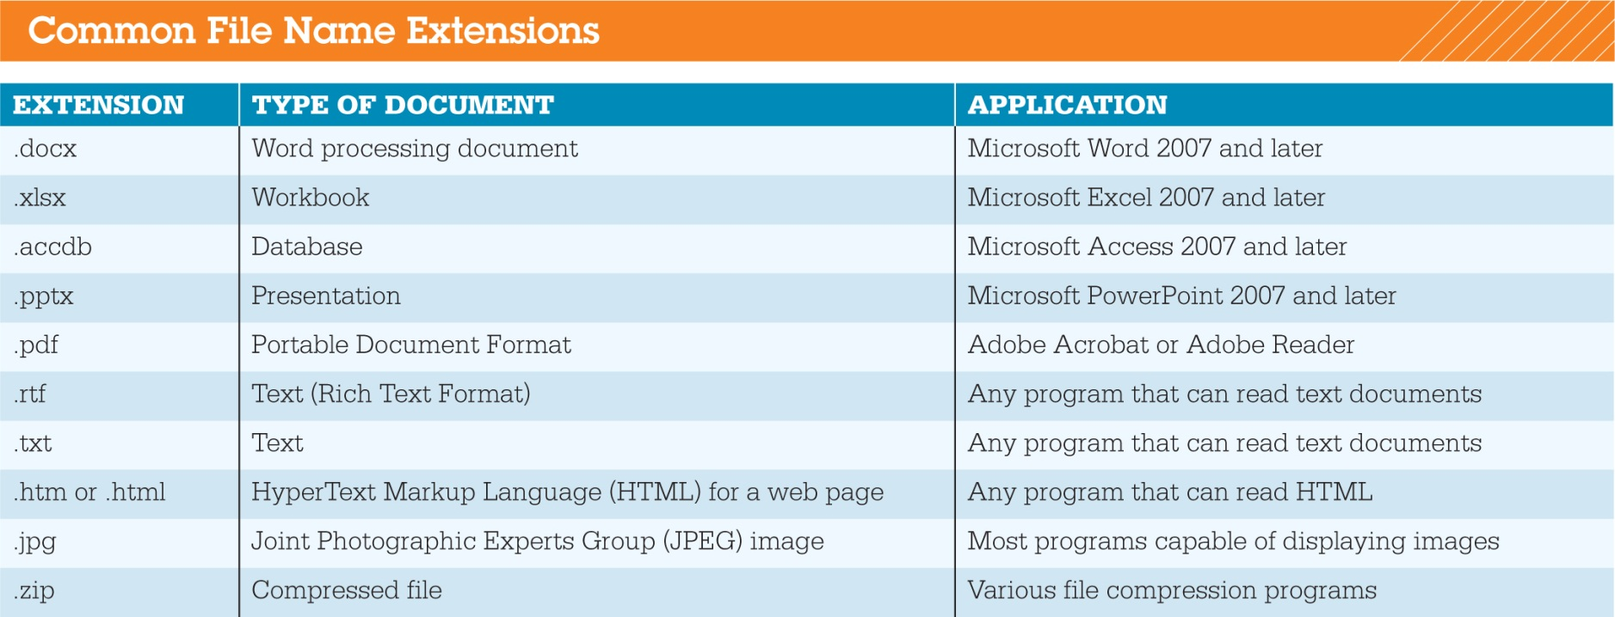
Organizing Your Computer: File Management: Naming Files (cont.)
Notes:
Have you ever received a file by e-mail and couldn’t open it? Most likely that was because your computer didn’t have the program needed to open the file. Sometimes, similar programs that you already have installed can be used to open the file, so it’s helpful to know what the file extension is. Sites such as FILExt (filext.com) can help you identify the source program.

Slide 53
Organizing Your Computer: File Management: Naming Files (cont.)
Naming conventions
Up to 255 characters
All files must be uniquely identified
Notes:
Each OS has its own naming rules. Beyond those rules, it’s important to name your files so they are easily identifiable. File names can have as many as 255 characters. A file name such as “BIO Research Paper Draft.docx” makes it very clear what the file contains.
All files must be uniquely identified, unless they are saved in different folders or locations. Files might share the same file name (“bioreport.docx” and “bioreport.xlsx”) or the same extension (“bioreport.xlsx” and “budget.xlsx”), no two files stored on the same device and folder can share both the same file name and extension.

Slide 54
Organizing Your Computer: File Management: Naming Files (cont.)
File Save Location
Determine location of a file by its file path
File path
Notes:
When you save a file for the first time, you give the file a name and designate where you want to save it. For easy reference, the OS includes libraries where files are saved unless you specify otherwise. In Windows, the default libraries are Documents for files, Music for audio files, Pictures for graphics files, and Videos for video files.
You can determine the location of a file by its file path. The file path starts with the drive in which the file is located and includes all folders, subfolders (if any), the file name, and the extension.

Slide 55
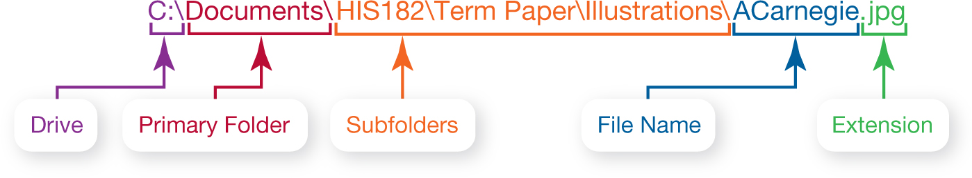
Organizing Your Computer: File Management: Naming Files (cont.)
Notes:
If you were saving a picture of Andrew Carnegie, the file path might be C:\Documents\HIS182\Term Paper\Illustrations\ACarnegie.jpg. “C:” is the drive on which the file is stored, and Documents is the file’s primary folder. “HIS182,” “Term Paper,” and “Illustrations” are successive subfolders within the Documents main folder. Last comes the file name, “ACarnegie,” separated from the file extension (in this case, “jpg”) by a period. The backslash characters (\), used by Windows, are referred to as path separators. OS X files use a colon (:), and UNIX and Linux files use the forward slash (/) as the path separator.

Slide 56
Organizing Your Computer: File Management: Working with Files
File-management actions
Open
Copy
Move
Rename
Delete
Notes:
File-management actions include opening, copying, moving, renaming, and deleting files.
You open a file by double-clicking the file.
The Copy command copies the file.
The Cut command can be used to move a file. Both of these commands can be accessed by right-clicking on a file’s name.
The Recycle Bin is a folder on the desktop where files deleted from the hard drive reside until permanently deleted. Files from other drives and stored in the cloud are not cycled through the Recycle Bin.
To delete files on a Mac, drag the files to the Trash icon.

Slide 57
Organizing Your Computer: File Management: Working with Files (cont.)
Recovering deleted files
File History utility
File retrieval programs
FarStone’s RestoreIT
Norton Ghost
Notes:
Getting a file back after the Trash has been emptied still may be possible.
File History is a Windows 8 utility that automatically backs up files and saves previous versions of files to a designated drive. If you’re using File History, you can restore deleted files or previous versions of files.
When the Trash is emptied, only the reference to the file is deleted permanently, so the OS cannot easily find it. The actual file remains on the hard drive until it’s written over. Programs such as FarStone’s RestoreIT or Norton Ghost can be used to try to retrieve files.

Slide 58
Utility Programs
Incorporated into operating system
Firewall and file-compression utilities
Standalone utility programs
Antivirus and security programs
Freeware
Notes:
Utility programs are small applications that perform special functions.
Utility programs come in three flavors:
Those that are included with the OS (such as System Restore)
Those sold as standalone programs (such as antivirus software)
Those offered as freeware (such as anti-malware software like Ad-Aware from Lavasoft)
The basic utilities designed to manage and tune the computer hardware are incorporated into the operating system.
The stand-alone utility programs typically offer more features or an easier user interface for backup, security, diagnostic, or recovery functions. For some Windows programs, like Task Manager and Resource Monitor, no good standalone alternative exists.

Slide 59
Utility Programs: Display Utilities
Personalization
Background
Screen savers
Window colors
Downloadable options
Notes:
You can personalize the Start screen and the lock screen (the screen that forces you to enter a password to resume using your computer) to suit your tastes. To do so, display the Charms bar, select Settings, choose Change PC settings, and then the Personalize option.
This provides you with access to personalization options such as changing pictures, colors, and backgrounds. This also provides you with access to all the features you need to change the appearance of your desktop.

Slide 60
Utility Programs: The Programs and Features Utility
Installing a new program
Installation wizard
Notes:
When you download Windows 8 apps from the Windows Store, they automatically install on your computer. If you install non – Windows 8 programs, the program usually automatically runs a wizard (a step-by-step guide) that walks you through the installation process. If a wizard does not start automatically, open the Control Panel, click Programs, and then click Programs and Features. This prompts the OS to look for the setup program of the new software and starts the installation wizard.

Slide 61
Utility Programs: File Compression Utilities
Make a large file more compact
Easier and faster to send files
Built-in file compression
Removes redundancies
Repeated patterns
Notes:
File compression makes a large file more compact, making it easier and faster to e-mail large attachments, upload them to the web, or save them.
Windows has a built-in file compression utility that takes out redundancies to reduce the size. You can also obtain several standalone freeware and shareware programs to compress your files.
Most compression programs look for repeated patterns of letters and replace them with a shorter placeholder. The patterns and the placeholder are catalogued and stored in a separate file called the dictionary.
To restore the file to its original state, you need to decompress the file.

Slide 62
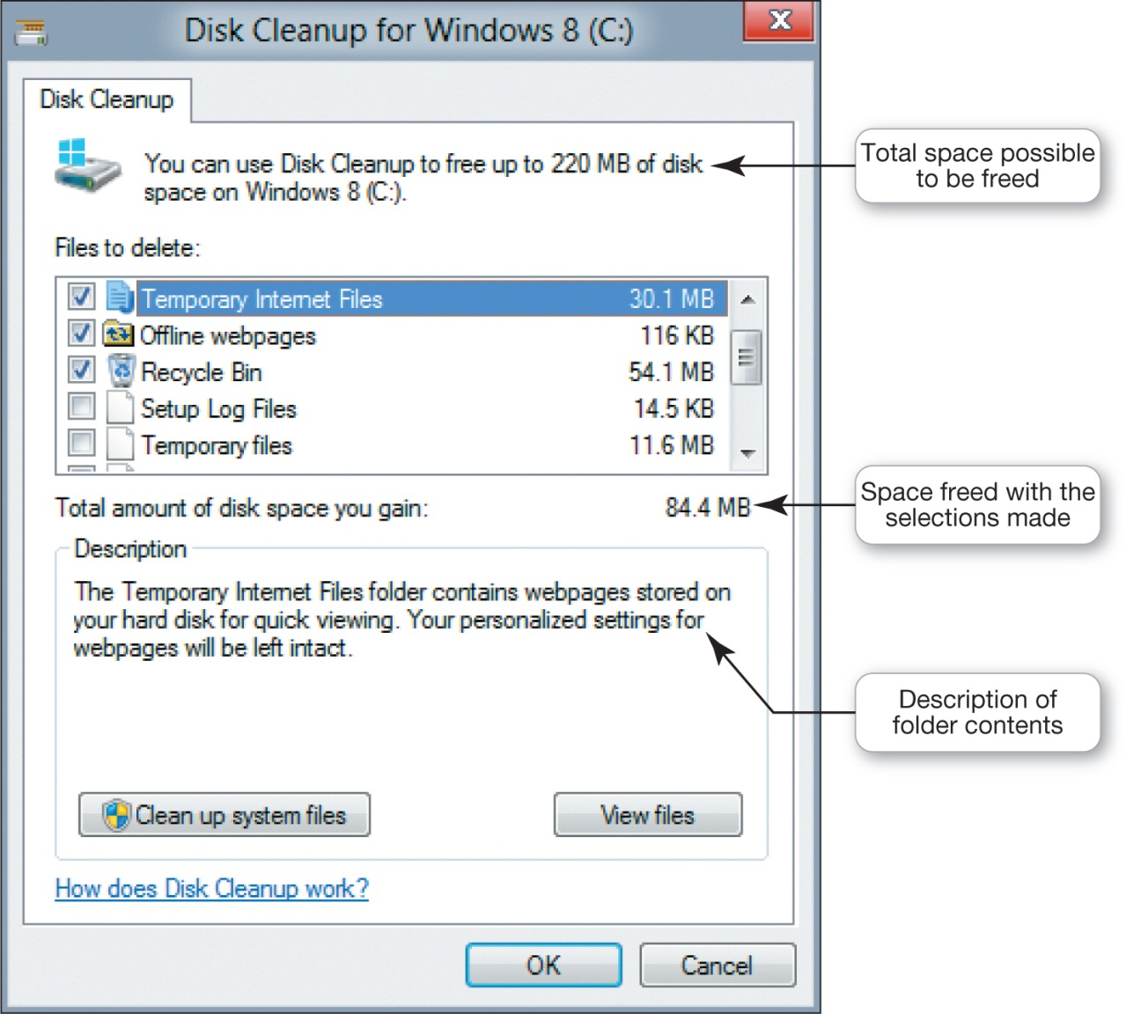
Utility Programs: System Maintenance Utilities
Notes:
Disk Cleanup is a Windows utility that removes unnecessary files from your hard drive. These include files that have accumulated in the Recycle Bin as well as temporary files.
Disk Cleanup also removes temporary Internet files as well as offline web pages. If not deleted periodically, these unnecessary files can slow down your computer.
When you run Disk Cleanup, the program scans your hard drive to determine which folders have files that can be deleted and calculates the amount of hard drive space that would be freed. You check off which type of files you would like to delete.

Slide 63
Utility Programs: System Maintenance Utilities (cont.)
Error-checking
Disk Defragmenter
FAT
Notes:
Error-checking is a Windows utility that checks for lost files and fragments as well as physical errors on your hard drive.
Sometimes the system becomes confused, leaving references on the file allocation table or FAT (an index of all sector numbers in a table) to files that no longer exist or have been moved. Physical errors on the hard drive’s data mean the system can no longer determine whether the area holds a 1 or a 0. These are called bad sectors. Sometimes Error-checking can recover lost data, but more often, it deletes the files that are taking up space.

Slide 64
Utility Programs: System Maintenance Utilities (cont.)
Task Manager
Notes:
Windows Task Manager utility is used to check on programs or to exit the nonresponsive programs. In Windows 8.1, the Processes tab of Task Manager lists all the program you are using and indicates their status. “Not responding” will be shown next to a program that stopped improperly.

Slide 65
Utility Programs: System Restore and Backup Utilities
System restore point
Made every week
Before installing software
Custom restore point
Notes:
Windows has a utility called System Restore that lets you roll your system settings back to a specific date when everything was working.
A system restore point, which is a snapshot of your entire system’s settings, is generated prior to certain events or automatically once a week if no other restore points were created in that time. You also can create a restore point manually at any time.
If a problem occurs you can restore your computer to the settings before the problem.
System Restore doesn’t affect your personal data files, so you won’t lose changes made to these files.

Slide 66
Utility Programs: System Restore and Backup Utilities (cont.)
File History utility in Windows 8.1
Backup
Notes:
The Windows 8.1 File History utility automatically creates a duplicate of libraries, desktop, contacts, and favorites and copies it to a storage device.
A backup copy protects your data in case your hard drive fails or files are erased. File History keeps copies of different versions of files so you can recover a different draft. File History needs to be turned on and requires an external hard drive is always connected.
OS X includes a backup utility called Time Machine that automatically backs up files. Apple also offers backup hardware called Time Capsules designed to work with Time Machine.

Slide 67
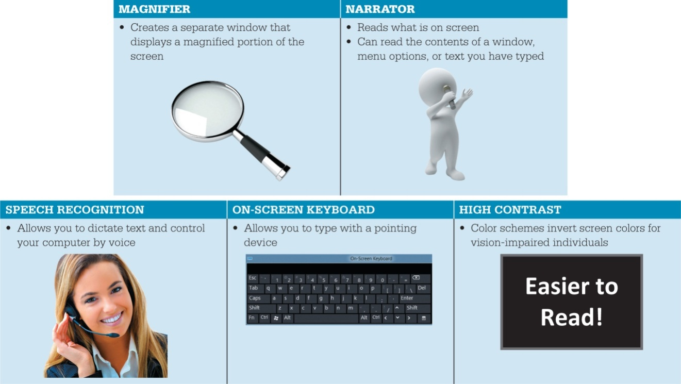
Utility Programs: Accessibility Utilities
Ease of Access Center
Notes:
Microsoft Windows includes an Ease of Access Center, which is a centralized location for assistive technology and tools to adjust accessibility settings.
In the Ease of Access Center, which is accessible from the Control Panel, you can find the tools to help users with disabilities. If you’re not sure where to start or what settings might help, a questionnaire asks you about routine tasks and provides a personalized recommendation for settings that will allow you to better use your computer.

Slide 68
Chapter 5 Summary Questions
What software is included in system software?
Notes:
System software is the set of software programs that helps run the computer and coordinates instructions between application software and hardware devices. It consists of the operating system (OS) and utility programs. The OS controls how your computer system functions. Utility programs are programs that perform general housekeeping tasks for the computer, such as system maintenance and file compression.

Slide 69
Chapter 5 Summary Questions
What are the different kinds of operating systems?
Notes:
There are many different kinds of operating systems. Real-time operating systems (RTOSs) require no user intervention. They are designed for systems with a specific purpose and response time. A multiuser operating system (network operating system) provides access to a computer system by more than one user at a time. Smartphones have their own specific operating systems. Tablets use operating systems (such as iOS, Android, and Windows 8) that allow interaction with touchscreen interfaces. Gaming consoles use operating systems developed specifically for those particular devices. Current operating systems for desktops, laptops, and netbooks have multitasking and networking capabilities.

Slide 70
Chapter 5 Summary Questions
What are the most common operating systems?
Notes:
Microsoft Windows is the most popular OS. It has evolved into a powerful multiuser OS. The most recent release is Windows 8.1. Another popular OS is the Mac OS, which is designed to work on Apple computers. Apple’s most recent release, Mac OS X, is based on the UNIX OS. There are various versions of UNIX on the market, although UNIX is most often used on servers and networks. Linux is an open source OS based on UNIX and designed primarily for use on personal computers, although it is often used on servers and supercomputers.

Slide 71
Chapter 5 Summary Questions
How does the operating system provide a means for users to interact with the computer?
Notes:
The OS provides a user interface that enables users to interact with the computer. Most OSes today use a graphical user interface (GUI). Unlike the command- and menu-driven interfaces used many years ago, GUIs display graphics and use the point-and-click technology of the mouse and cursor (or touch-sensitive screens), making the OS more user-friendly. Common features of GUIs include windows, menus, and icons.

Slide 72
Chapter 5 Summary Questions
How does the operating system help manage resources such as the processor, memory, storage, hardware, and peripheral devices?
Notes:
When the OS allows you to perform more than one task at a time, it is multitasking. To provide for seamless multitasking, the OS controls the timing of the events on which the processor works. The OS uses RAM as a temporary storage area for instructions and data. If there isn’t sufficient space in RAM, then the OS allocates the least necessary files to virtual memory. The OS manages storage by providing a file management system. Device drivers facilitate communication between devices attached to the computer and the OS.

Slide 73
Chapter 5 Summary Questions
How does the operating system interact with application software?
Notes:
All software applications need to interact with the CPU. For programs to work with the CPU, they must contain code that the CPU recognizes. Rather than having the same blocks of code appear in each application, the OS includes the blocks of code to which software applications refer. These blocks of code are called application programming interfaces (APIs).

Slide 74
Chapter 5 Summary Questions
How does the operating system help the computer start up?
Notes:
When you start your computer, it runs through a special process called the boot process. The boot process consists of four basic steps: (1) The basic input/output system (BIOS) is activated when the user powers on the CPU. (2) In the POST check, the BIOS verifies that all attached devices are in place. (3) The OS is loaded into RAM. (4) Configuration and customization settings are checked.

Slide 75
Chapter 5 Summary Questions
What are the main features of the Windows interface?
Notes:
In Windows 8, the Start screen provides your first interaction with the OS and is the first image you see on your monitor once the system has booted up. It provides you with access to your computer’s apps, tools, and commonly used programs. The Windows 8 interface is designed for touchscreen devices. Windows 8 apps run full-screen and feature commands hidden in app bars. Non-Windows 8 programs run on the desktop.

Slide 76
Chapter 5 Summary Questions
How does the operating system help you keep your computer organized?
Notes:
The OS allows you to organize the contents of your computer in a hierarchical structure of directories that includes files, folders, libraries, and drives. File Explorer helps you manage your files and folders by showing the location and contents of every drive, folder, and file on your computer. Creating folders is the key to organizing files because folders keep related documents together. Following naming conventions and using proper file extensions are also important aspects of file management.

Slide 77
Chapter 5 Summary Questions
What utility programs are included in system software and what do they do?
Notes:
Some utility programs are incorporated into the OS; others are sold as standalone off-the-shelf programs. Common Windows utilities include those that enable you to adjust your display, add or remove programs, compress files, clean unnecessary files off your system, check for lost files and errors, restore your system to an earlier setting, back up your files, and check on programs that have stopped running.

Slide 78
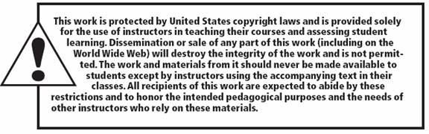
All rights reserved. No part of this publication may be reproduced, stored in a retrieval system, or transmitted, in any form or by any means, electronic, mechanical, photocopying, recording, or otherwise, without the prior written permission of the publisher. Printed in the United States of America.
Copyright © 2015 Pearson Education, Inc.

